Slide 1
Sujata Desai
ECONOMICS

Slide 2
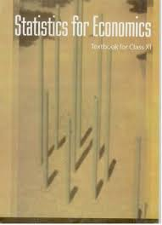
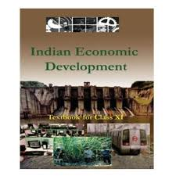
Economics : XI
Part A: Part B:
Part C: Project

Slide 3
Statistics for Economics
Units: Marks
1. Introduction
2. Collection , organization and 13
presentation of data
3. Statistical tools and 27
interpretation
Total 40

Slide 4
Indian Economic Development
Units : Marks
4. Development experience (1947-90) 13
&
Economic reforms 1991 12
5. Current challenges facing 15
Indian Economy
6. Development experience of India 10
with neighbors
Total 50

Slide 5
Project [10 marks]
Some of the examples of projects are
A report on demographic structure of your neighborhood.
Changing consumer awareness among household
Study of a cooperative institutions : milk cooperatives, marketing cooperatives etc…
Impact of global warming
Developing eco-friendly products applicable in school
Case study on public –private partnership, outsourcing and outward foreign direct investment

Slide 6
Open text based assessment (OTBA)
The question paper will include a section on OTBA of 10 marks from unit : 6 of part B.
This questions will be asked only during the annual examination.
It is designed to test the higher order thinking skills of students.

Slide 7
Statistic for Economics Unit : 1 Introduction
Content to be learn:
What is Economics?
What is Statistics ?
Meaning , scope and importance of statistics in Economics

Slide 8
UNIT 2 : Collection, organisation and presentation of data
Content to be learn:
Collection of data: sources of data, methods of collecting data, important sources of collecting data and census of India and NSSO.
Organization of data: meaning and types of variables, frequency distribution.
Presentation of data : Tabular and diagrammatic presentation of data
Geometric forms : bar diagram and pie diagram
Frequency diagrams: histogram, polygon and ogive and Arithmetic line graphs : time series graphs

Slide 9
Unit 3 : Statistical tools and interpretation
Content to be learn:
Measures of Central Tendency : Mean , Median and Mode
Measures of dispersion : Absolute dispersion, relative dispersion, Lorenz curve
Correlation : Meaning, Scatter diagrams, measures of correlation
Introduction to Index Numbers: Meaning, Types : WPI, CPI, index of industrial production, uses of index numbers

Slide 10
Indian Economic Development Unit 4 : Development experience (1947-90) and Economic Reforms since 1991
Content to be learn:
A brief introduction of state of Indian economy on the eve of independence.
Common goals of five year plan.
Main features, problems and policies of agriculture, industry and foreign trade.
Economic Reforms since 1991: Need and features of LPG, an appraisal of LPG policies

Slide 11
Unit 5 : Current challenges facing Indian Economy
Content to be learn:
Poverty
Rural development
Human Capital Formation
Employment
Inflation
Infrastructure
Sustainable Economic development

Slide 12
Development experience of India
Content to be learn:
A comparison with neighbors
India and Pakistan

Slide 13
Economics : XII
Section A: Section B:

Slide 14
Introductory Micro Economics :
Unit 1 : Introduction 06
Unit 2 : Consumer’s equilibrium and
theory of Demand 16
Unit 3 : Producer’s behaviour and
theory of Supply 16
Unit 4 : Forms of market and Price Determination under Perfect competition 12
50

Slide 15
Introductory Macro Economics
Unit 5 : National Income and Related
Aggregates 15
Unit 6 : Money and Banking 08
Unit 7 : Determination of Income and
Employment 12
Unit 8 : Government budget and the
Economy 08
Unit 9 : Balance of Payments 07
50

Slide 16
Unit 1 : Introduction of Micro and Macro Economics
Content to be learn:
Meaning of Micro and Macro Economics
What is an economy?
Central problems of an economy
Production possibility curve and opportunity cost

Slide 17
Unit 2 : Consumer’s equilibrium and theory of Demand
Conditions of consumer equilibrium using Utility and Indifference Curve approach
Theory of demand : meaning of demand, demand curve, determinants of demand, elasticity of demand, factors affecting price elasticity of demand, measurement of price elasticity demand using three methods
i) Percentage method
ii) Geometric method
iii) total outlay method

Slide 18
Unit 3 : producer’s behaviour and theory of Supply
Content to be learn:
Production function
Returns to a factor
Cost and revenue
Producer’s equilibrium and its conditions in terms of MR-MC
Supply , determinants of supply, elasticity of supply and its measurement using percentage method and Geometric method

Slide 19
Unit 4 : Forms of market and Price determination under perfect competition.
Content to be learn:
Perfect competition – features, determination of market equilibrium and effects of shift in demand and supply.
Other market forms – Monopoly, monopolistic competition, oligopoly – their meaning and features
Simple application of Demand and Supply- Price ceiling and price flore.

Slide 20
Unit 5 : National income and Related Aggregates
Content to be learn:
Some basic concepts : consumption good, capital good, final goods , intermediate goods, stocks and flow
Circular flow of income
Methods of calculating National Income
Aggregates related to National Income
GDP, GNP, NNP, NDP etc…..

Slide 21
Unit 6 : Money and Banking
Content to be learn:
Money – its meaning and functions
Supply of money
Money creation by the commercial banking system
Central Bank and its functions

Slide 22
Unit 7 : Determination of Income and Employment
Content to be learn:
Aggregate demand and its components
Propensity to consume and propensity to save
Short run equilibrium output, investment multiplier and its mechanism
Meaning of full employment and involuntary unemployment
Problems of excess demand and deficient demand and measures to correct them.

Slide 23
Government budget and the Economy
Content to be learn:
Government budget – meaning, objectives and components
Measures of government deficit
Revenue deficit
Primary deficit
Fiscal deficit

Slide 24
Unit 9 :Balance of payments
Content to be learn:
Balance of payment account- meaning and components
Foreign exchange rate
Determination of exchange rate in a free market.

Slide 25
System of evaluation
Multi-
displinary
10%
Higher order thinking skills 20%
Remembering 25%
Application 20%
Comprehensive 25%

Slide 26
Why Economics ?

Slide 27
Understanding of some basic economic concepts and development of economic reasoning which learners can apply in their day to day life as responsible citizens of a nation.
Equipment with basic tools of Economics and Statistics to analyze economic issues.
Development of understanding that thee can be more than one view on any economic issue and necessary skill to argue logically with reasoning.

Slide 28
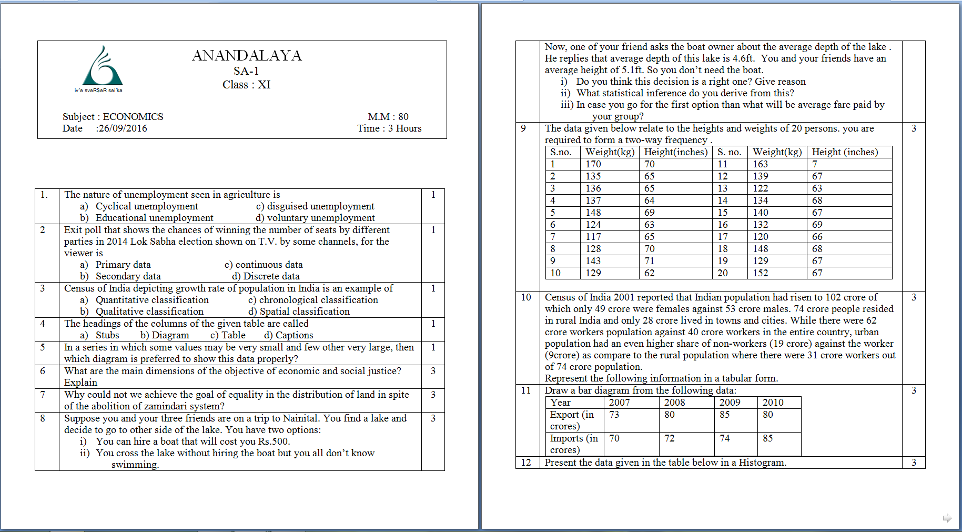
Sample Paper Standard 11th

Slide 29
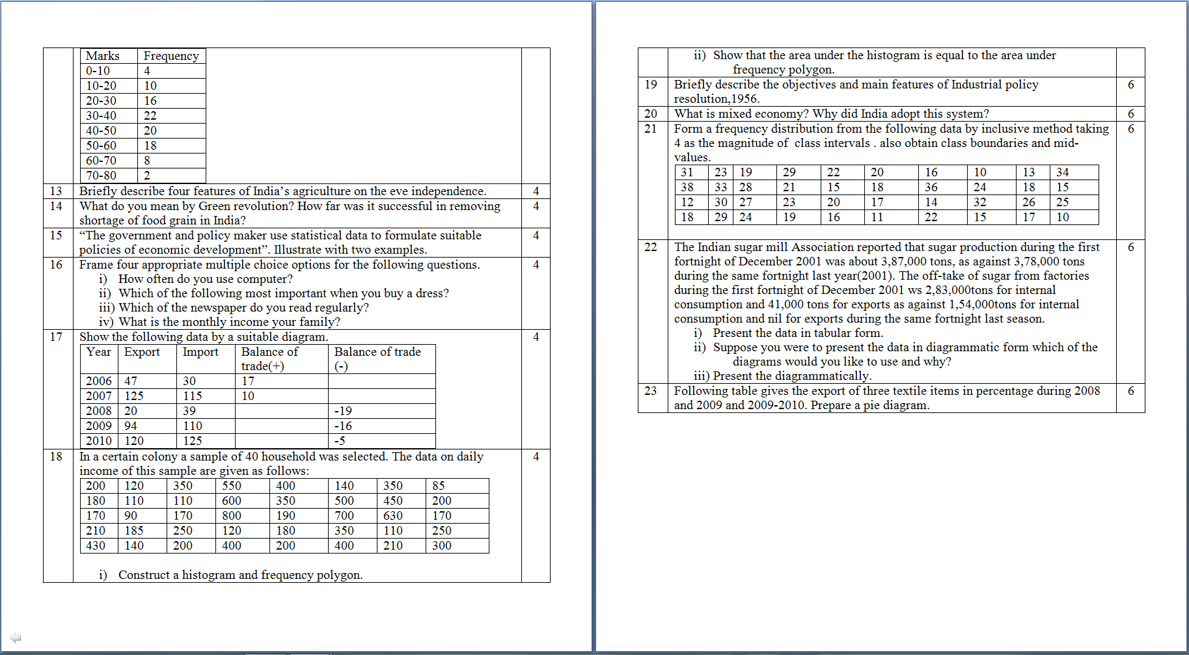

Slide 30
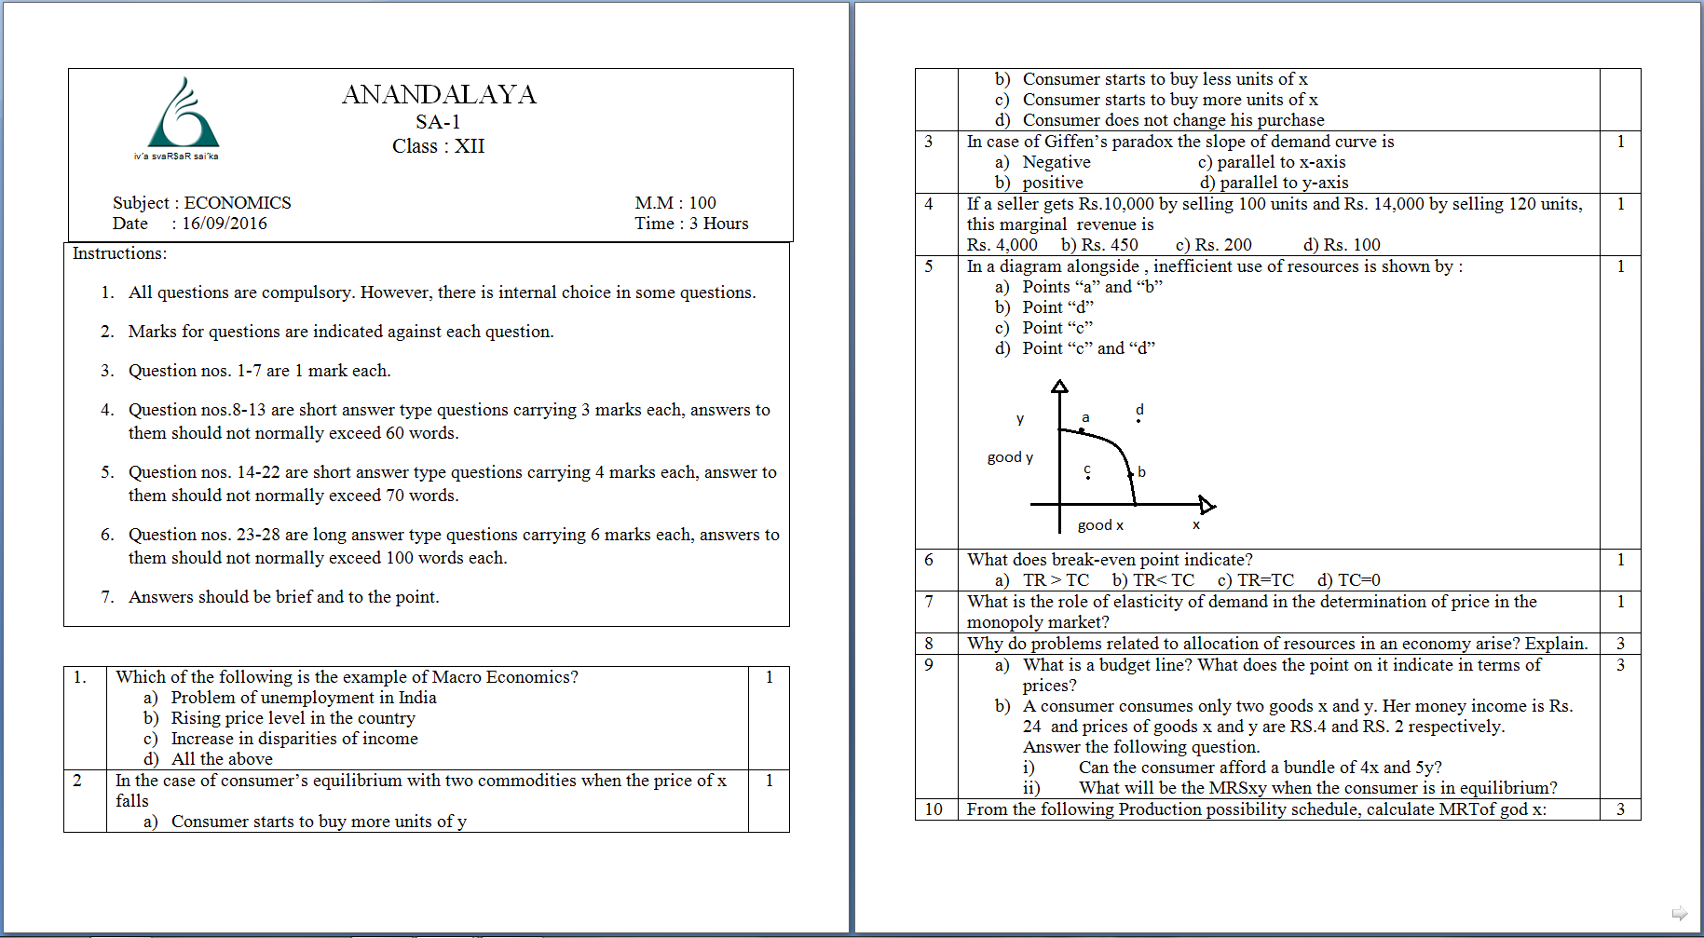
Sample Paper Standard 12th

Slide 31
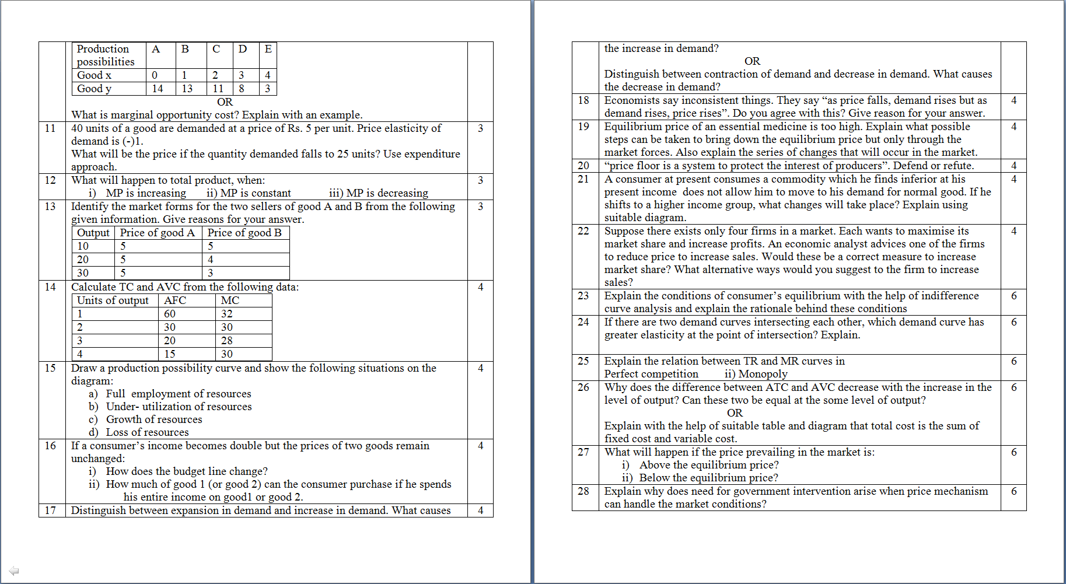

Slide 32
THANK YOU

